Slide 1
Input Device: Touch Screen

Slide 2
Touch Screen
A Touch screen is any monitor, based either on LCD (Liquid Crystal Display) or CRT (Cathode Ray Tube) technology, that accepts direct onscreen input. The ability for direct onscreen input is facilitated by an external (light pen) or an internal device (touch overlay and controller) that relays the X,Y coordinates to the computer.

Slide 3
Main Components of Touch Screen
Basic Touch screen has three main components: a touch sensor, a controller, and a software driver.
1. Touch Sensor
A touch screen sensor is a clear glass panel with a touch responsive surface. The touch sensor/panel is placed over a display screen so that the responsive area of the panel covers the viewable area of the video screen. There are several different touch sensor technologies on the market today, each using a different method to detect touch input. The sensor generally has an electrical current or signal going through it and touching the screen causes a voltage or signal change. This voltage change is used to determine the location of the touch to the screen.

Slide 4
Main Components of Touch Screen …
2. Controller
The controller is a small PC card that connects between the touch sensor and the PC. It takes information from the touch sensor and translates it into information that PC can understand. The controller is usually installed inside the monitor for integrated monitors or it is housed in a plastic case for external touch add-ons/overlays. The controller determines what type of interface/connection you will need on the PC. Integrated touch monitors will have an extra cable connection on the back for the touchscreen. Controllers are available that can connect to a Serial/COM port (PC) or to a USB port (PC or Macintosh). Specialized controllers are also available that work with DVD players and other devices.

Slide 5
Main Components of Touch Screen …
3. Software Driver
The driver is a software update for the PC system that allows the touchscreen and computer to work together. It tells the computer's operating system how to interpret the touch event information that is sent from the controller. Most touch screen drivers today are a mouse-emulation type driver. This makes touching the screen the same as clicking your mouse at the same location on the screen. This allows the touchscreen to work with existing software and allows new applications to be developed without the need for touchscreen specific programming. Some equipment such as thin client terminals, DVD players, and specialized computer systems either do not use software drivers or they have their own built-in touch screen driver.

Slide 6
Touch Screen Technology
Resistive
A resistive touch screen panel is composed of several layers. The most important are two thin metallic electrically conductive and resistive layers separated by thin space. When some object touches this kind of touch panel, the layers are connected at certain point; the panel then electrically acts similar to two voltage dividers with connected outputs. This causes a change in the electrical current which is registered as a touch event and sent to the controller for processing. When measuring press force, it is useful to add resistor dependent on force in this model -- between the dividers.

Slide 7
Touch Screen Technology (Cont.)
Resistive (Cont.)
A resistive touch panel output can consist of between four and eight wires. The positions of the conductive contacts in resistive layers differ depending on how many wires are used. When four wires are used, the contacts are placed on the left, right, top, and bottom sides. When five wires are used, the contacts are placed in the corners and on one plate.

Slide 8
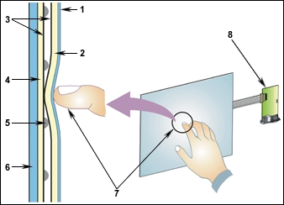
Resistive Touch Screen (continued)

Slide 9
Components of a Resistive Touch Screen
Polyester Film
Upper Resistive Circuit Layer
Conductive ITO (Transparent Metal Coating)
Lower Resistive Circuit Layer
Insulating Dots
Glass/Acrylic Substrate
Touching the overlay surface causes the (2) Upper Resistive Circuit Layer to contact the (4) Lower Resistive Circuit Layer, producing a circuit switch from the activated area.
The touchscreen controller gets the alternating voltages between the (7) two circuit layers and converts them into the digital X and Y coordinates of the activated area.

Slide 10
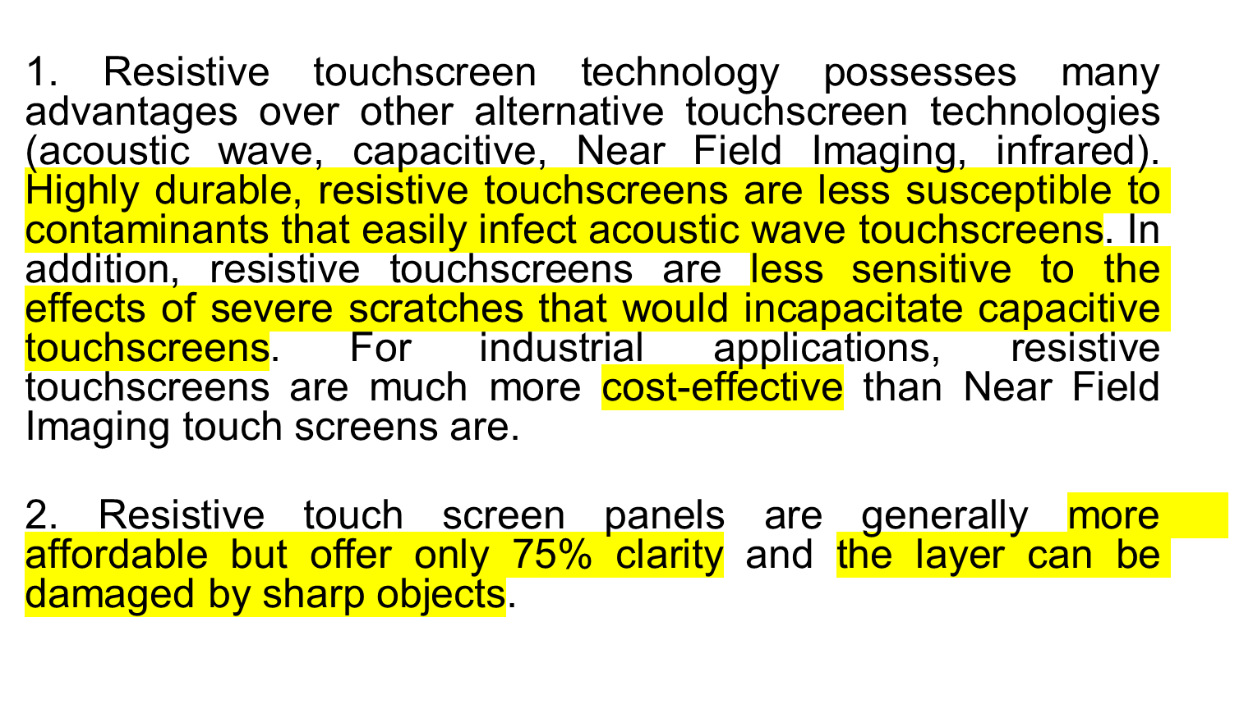
Advantages of Resistive Touch Screen

Slide 11
Touch Screen Technology (Cont.)
Surface Acoustic Wave (SAW)
Surface Acoustic Wave technology uses ultrasonic waves that pass over the touch screen panel. When the panel is touched, a portion of the wave is absorbed. This change in the ultrasonic waves registers the position of the touch event and sends this information to the controller for processing. Surface wave touch screen panels can be damaged by outside elements. Contaminants on the surface can also interfere with the functionality of the touchscreen.
Notes:
Ultrasonic-The frequencies which are beyond the limit of hearing. Frequencies are above 20 KHz.

Slide 12
Touch Screen Technology (Cont.)
Capacitive
A capacitive touch screen panel is coated with a material, typically indium tin oxide that conducts a continuous electrical current across the sensor. The sensor therefore exhibits a precisely controlled field of stored electrons in both the horizontal and vertical axes - it achieves capacitance. The human body is also an electrical device which has stored electrons and therefore also exhibits capacitance. When the sensor's 'normal' capacitance field (its reference state) is altered by another capacitance field, i.e., someone's finger, electronic circuits located at each corner of the panel measure the resultant 'distortion' in the sine wave characteristics of the reference field and send the information about the event to the controller for mathematical processing. Capacitive sensors can either be touched with a bare finger or with a conductive device being held by a bare hand. Capacitive touch screens are not affected by outside elements and have high clarity, but their complex signal processing electronics increase their cost.

Slide 13
Touch Screen Technology (Cont.)
Infrared
  An infrared touch screen panel employs one of two very different methodologies. One method used thermal induced changes of the surface resistance. This method was sometimes slow and required warm hands. Another method is an array of vertical and horizontal IR sensors that detected the interruption of a modulated light beam near the surface of the screen. IR touch screens have the most durable surfaces and are used in many military applications that require a touch panel display.

Slide 14
Touch Screen Technology (Cont.)
Strain Gauge
  In a strain gauge configuration the screen is spring mounted on the four corners and strain gauges are used to determine deflection when the screen is touched. This technology can also measure the Z-axis. Typically used in exposed public systems such as ticket machines due to their resistance to vandalism.

Slide 15
Touch Screen Technology (Cont.)
Optical Imaging
  A relatively-modern development in touch screen technology, two or more image sensors are placed around the edges (mostly the corners) of the screen. Infrared backlights are placed in the camera's field of view on the other sides of the screen. A touch shows up as a shadow and each pair of cameras can then be triangulated to locate the touch. This technology is growing in popularity, due to its scalability, versatility, and afford ability, especially for larger units.

Slide 16
Touch Screen Technology (Cont.)
Dispersive Signal Technology
  Introduced in 2002, this system uses sensors to detect the mechanical energy in the glass that occur due to a touch. Complex algorithms then interpret this information and provide the actual location of the touch. The technology claims to be unaffected by dust and other outside elements, including scratches. Since there is no need for additional elements on screen, it also claims to provide excellent optical clarity. Also, since mechanical vibrations are used to detect a touch event, any object can be used to generate these events, including fingers and styli.

Slide 17
Touch Screen Technology (Cont.)
Acoustic Pulse Recognition
  This system uses more than two piezoelectric transducers located at some positions of the screen to turn the mechanical energy of a touch (vibration) into an electronic signal. This signal is then converted into an audio file, and then compared to preexisting audio profile for every position on the screen. This system works without a grid of wires running through the screen, the touch screen itself is actually pure glass, giving it the optics and durability of the glass out of which it is made. It works with scratches and dust on the screen, and accuracy is very good. It does not need a conductive object to activate it. It is a major advantage for larger displays.

